Slide 1
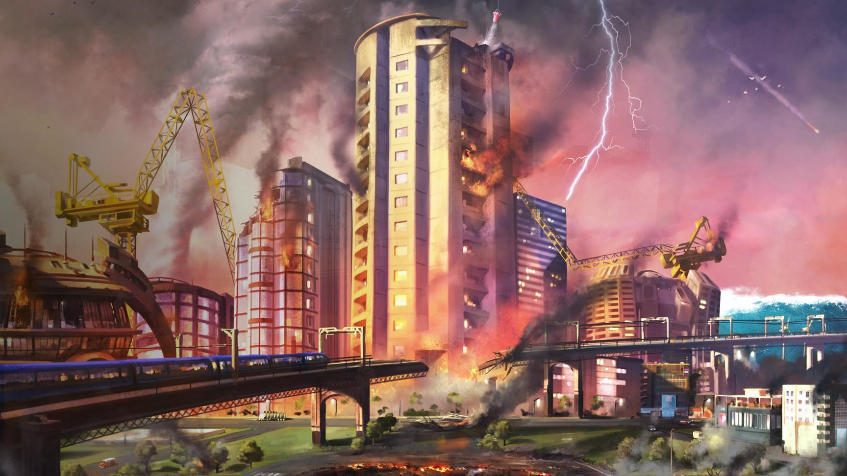
DASM
BBM406 PROJECT
MALEK BABA
EZGİ NAZ GÜNGÖR
FATMA NİSA HOPCU

Slide 2
What’s Damage Assessment?
DASM
Damage assessment is calculating the severity of the damage after disasters or just detecting if there’s any.
Damage assessment is an important task for governments and civil organizations, especially after high intensity disasters that affect large areas.

Slide 3
Why Damage Assessment?
Understanding the intensity of a disaster helps to organize relief efforts. But estimating the damage requires a lot of time and resources.
In the case of emergency response, it is important for early responders to know the type & location of the damage at the time of crisis.

Slide 4
Our Approach
. Bag Of Visual Words
. Oriented FAST and rotated BRIEF (ORB) features
. K-nearest neighbors
. Convolutional Neural Networks
. Transfer learning freezing and fine-tuning
. Different CNN architectures: AlexNet, VGG and Resnet

Slide 5
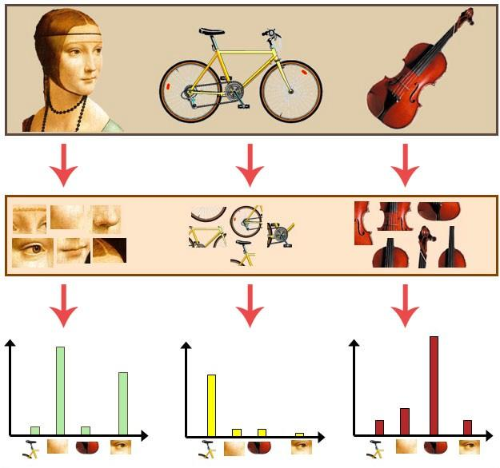
Bag Of Visual Words

Slide 6
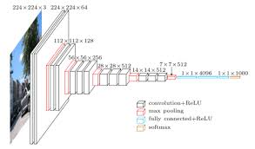
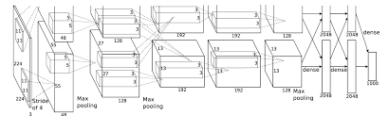
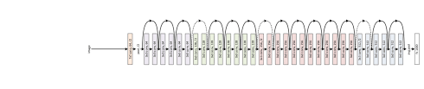
Convolutional neural networks

Slide 7
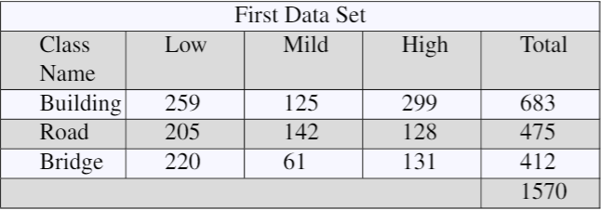
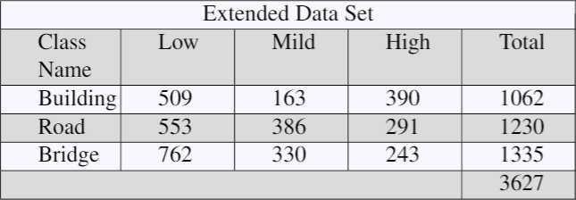
Our Dataset

Slide 8
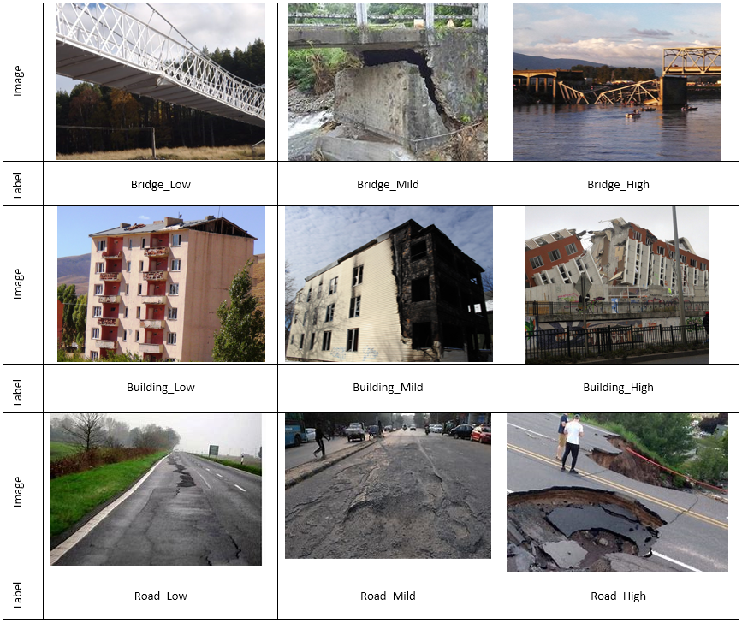

Slide 9
Bag Of Visual Words + KNN classifier
Average accuracy: %16.25
bridge_mid : %11.53
road_mid : %13.04
bridge_high : %9.52
road_low : %20.58
bridge_low : %20.35
road_high : %12.28
building_low : %23.15
building_mid : %3.12
building_high : %12.64
Average accuracy: %85.00
bridge_low : %78.57
bridge_high : %89.36
bridge_mid : %74.19
road_low : %84.44
road_mid : %89.65
road_high : %84.61
building_low : %86.89
building_mid : %89.47
building_high : %84.09
First Dataset ===>
Extended Dataset ===>

Slide 10
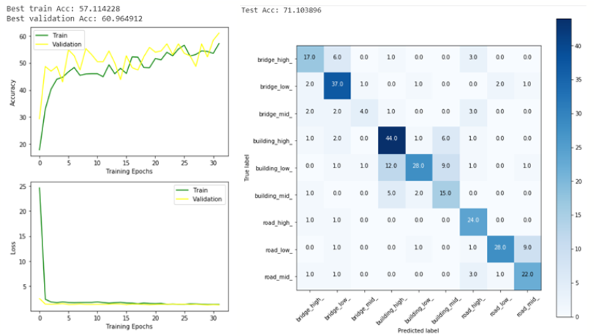
Evaluation And Results
First DataSet
(65 15 20)
VGG16 Architecture
Adam Optimizer
Learning rate = 0.005
epoch = 32
batchsize = 64
Train Acc = 57.114
Validation Acc = 60. 965
Test Acc = 71. 104

Slide 11
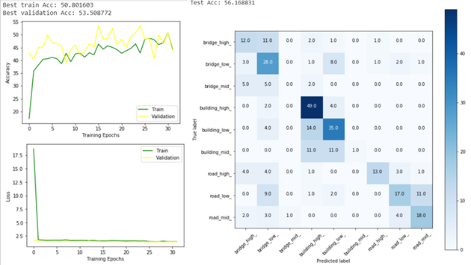
Evaluation And Results
First DataSet
(65 15 20)
AlexNet Architecture
Adam Optimizer
Learning rate = 0.005
epoch = 32
batchsize = 64
Train Acc = 50.802
Validation Acc = 53.877
Test Acc = 56.169

Slide 12
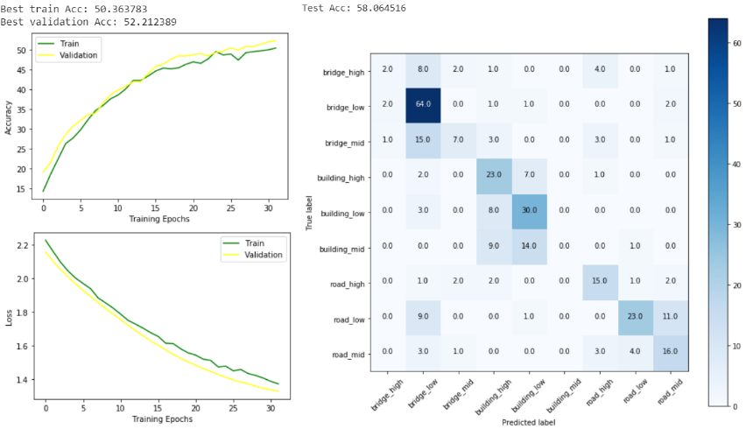
Evaluation And Results
Extended DataSet
(80 10 10)
VGG Architecture
SGD Optimizer
Learning rate = 0.001
epoch = 32
batchsize = 32
Train Acc = 50.364
Validation Acc = 52.212
Test Acc = 58.064

Slide 13
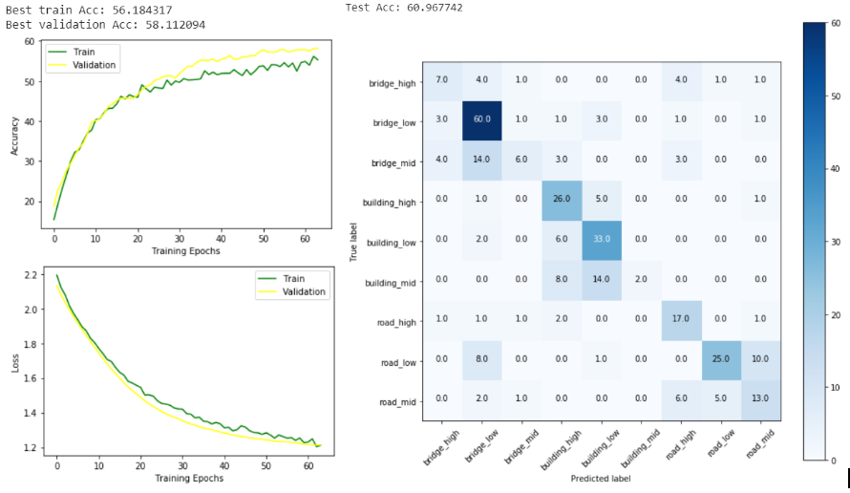
Evaluation And Results
Extended DataSet
(80 10 10)
VGG Architecture
SGD Optimizer
Learning rate = 0.001
epoch = 64
batchsize = 32
Train Acc = 56.184
Validation Acc = 58.112
Test Acc = 60.968

Slide 14
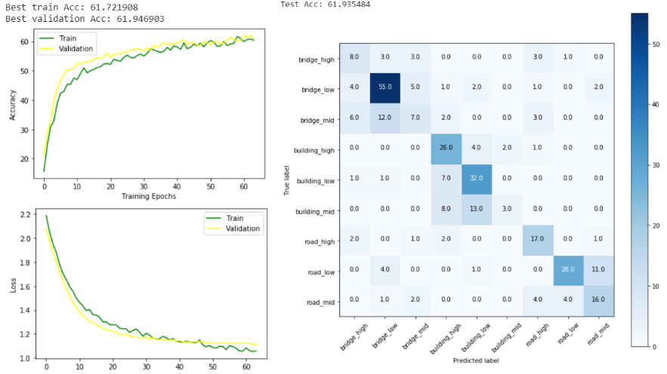
Evaluation And Results
Extended DataSet
(80 10 10)
VGG Architecture
SGD Optimizer
Learning rate = 0.005
epoch = 64
batchsize = 64
Train Acc = 61.722
Validation Acc = 61.947
Test Acc = 61.935

Slide 15
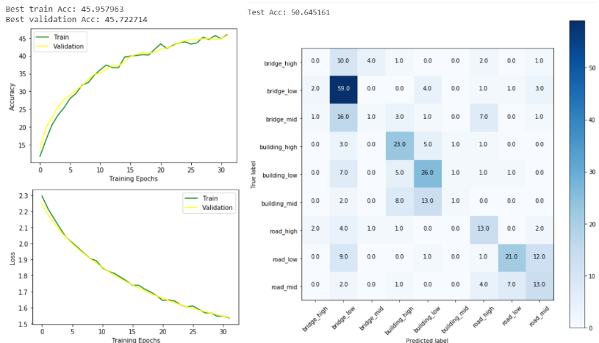
Evaluation And Results
Extended DataSet
(80 10 10)
AlexNet Architecture
SGD Optimizer
Learning rate = 0.001
epoch = 32
batchsize = 64
Train Acc = 45.958
Validation Acc = 45.723
Test Acc = 50.645

Slide 16
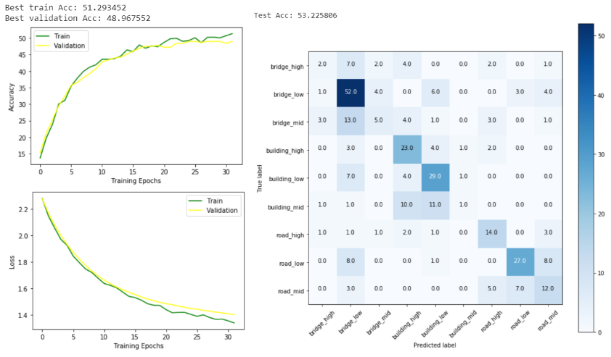
Evaluation And Results
Extended DataSet
(80 10 10)
AlexNet Architecture
SGD Optimizer
Learning rate = 0.001
epoch = 32
batchsize = 32
Train Acc = 51.293
Validation Acc = 48.967
Test Acc = 53.226

Slide 17
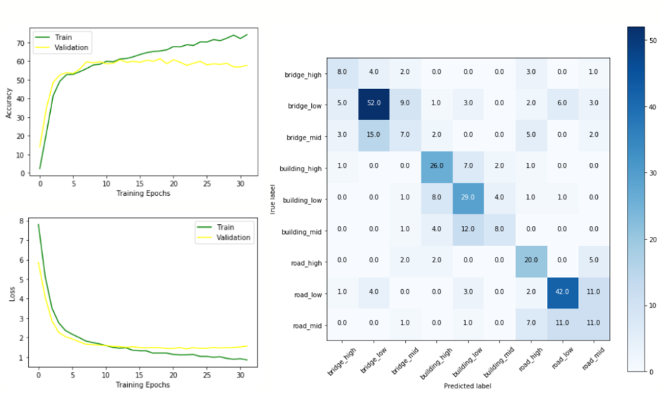
Evaluation And Results
Extended DataSet
(80 10 10)
ResNet101 Architecture
SGD Optimizer
Learning rate = 0.001
epoch = 32
batchsize = 32
Train Acc = 74.147
Validation Acc = 61.264
Test Acc = 56.077

Slide 18
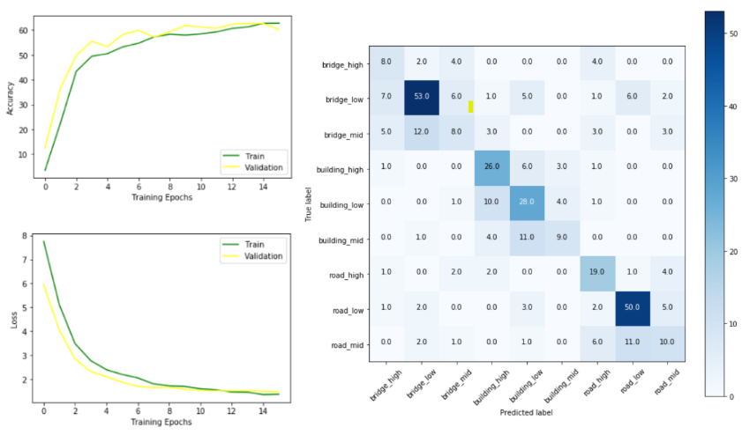
Evaluation And Results
Extended DataSet
(80 10 10)
ResNet101 Architecture
SGD Optimizer
Learning rate = 0.001
epoch = 16
batchsize = 32
Train Acc = 62.737
Validation Acc = 62.637
Test Acc = 58.287

Slide 19
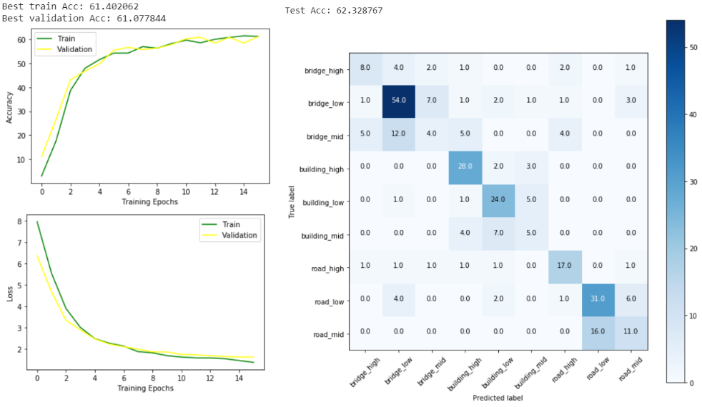
Evaluation And Results
Extended DataSet
(80 10 10)
ResNet50 Architecture
SGD Optimizer
Learning rate = 0.001
epoch = 16
batchsize = 32
Train Acc = 61.402
Validation Acc = 61.078
Test Acc = 62.329

Slide 20
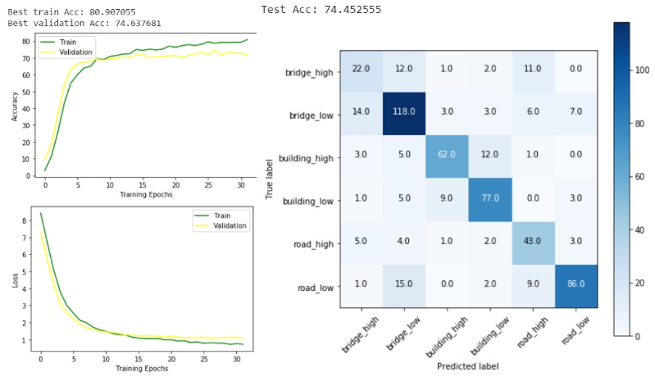
Evaluation And Results
Extended DataSet
(65 15 20)
Without Mild Classes
ResNet50 Architecture
SGD Optimizer
Learning rate = 0.001
epoch = 32
batchsize = 32
Train Acc = 80.907
Validation Acc = 74.638
Test Acc = 74.452

Slide 21
Results
Bag of words performance decreased when the data is increased (large number of noise).
Deep learning models performance was almost the same after we enlarged the dataset.
Fine Tuning the entire model or just training the final layer, gave us almost the same results.

Slide 22
Strengths and Weaknesses
 | Strengths | Weaknesses
Dataset | - | Small
Supported Categories | - | Very Few
Methodology | Different and broad methods are tried and tested | -
Accuracy | Good | Good
Usability | Usable than other approaches that utilize Satellite or UAV images | Varying point-of-view of the images makes it harder to predict

Slide 23
Related Work
Damage assessment and disaster response are subjects that are researched for a long time, however with the success of neural networks there has been an increase in the studies.

Slide 24
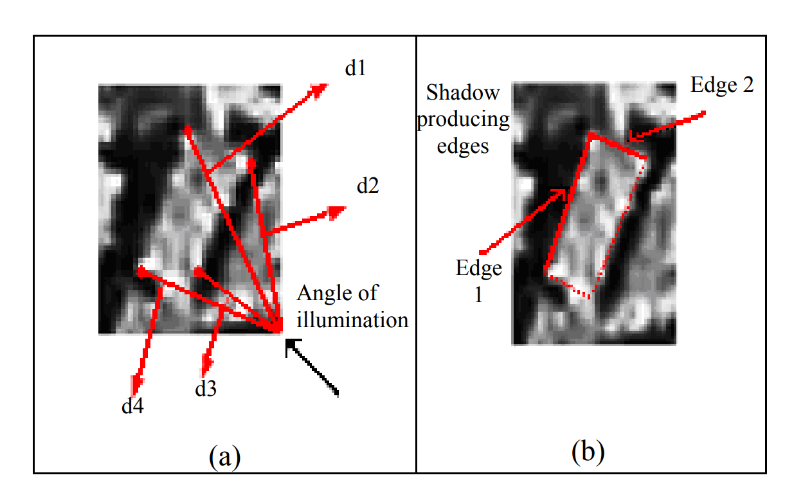
Earlier Studies
Edge detection method

Slide 25
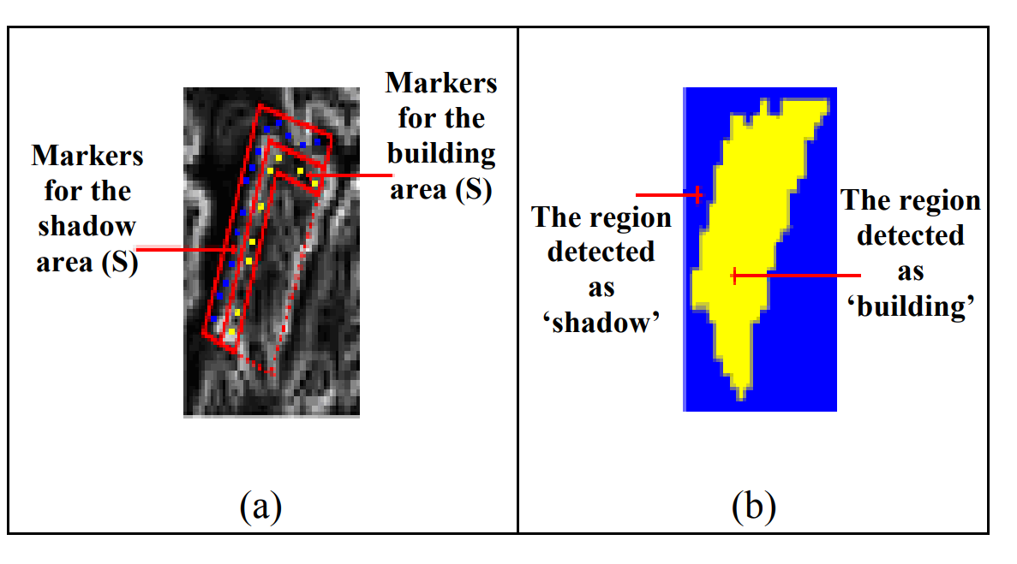
Earlier Studies
Edge detection method: Detecting buildings and their shadows.

Slide 26
Recent Studies
Disaster specific datasets (Hurricane Matthew, Typhoon Ruby etc.), satellite imagery
Image Classification & Object Detection with CNNs (low to high damage)
Data processing methods (such as masking)

Slide 27
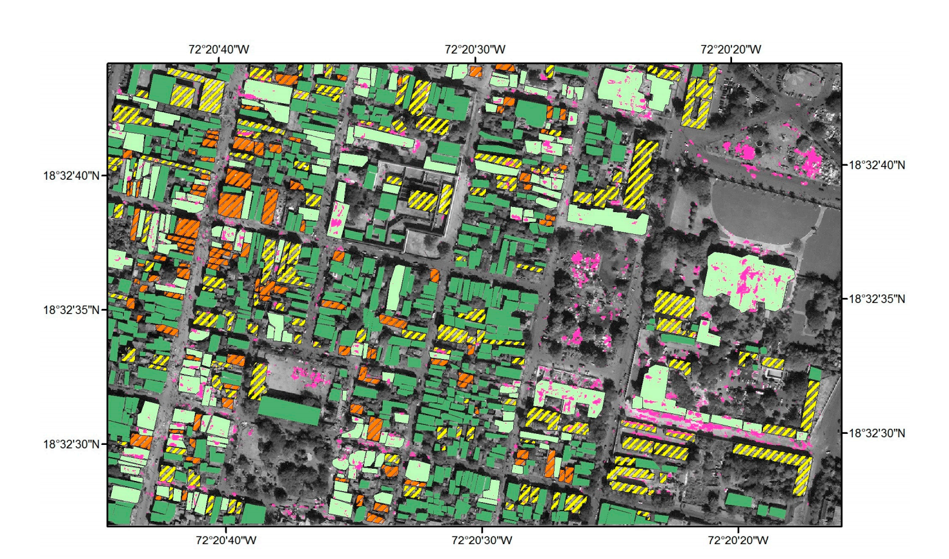

Slide 28
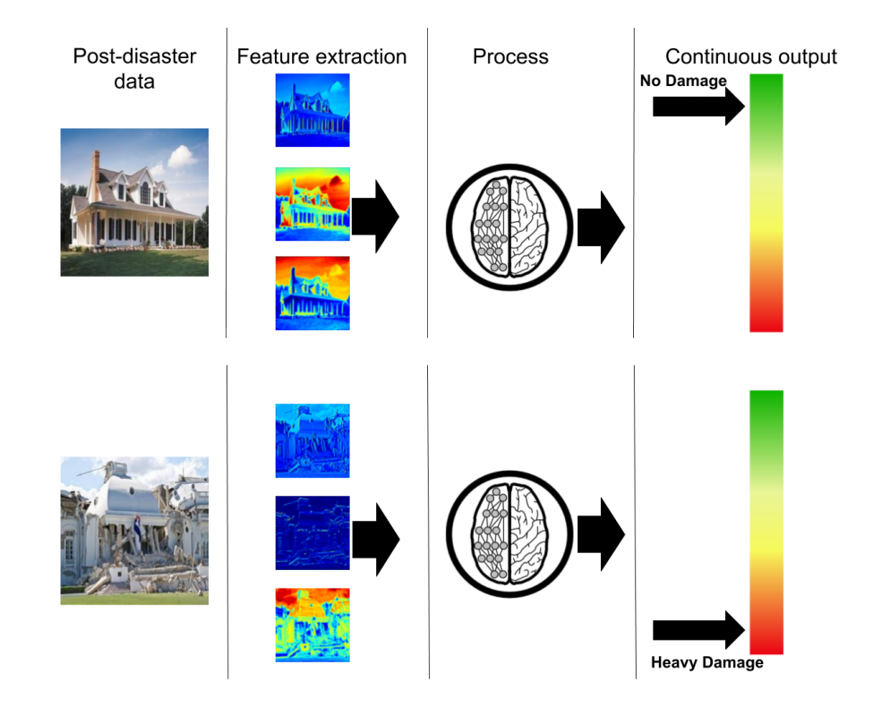

Slide 29
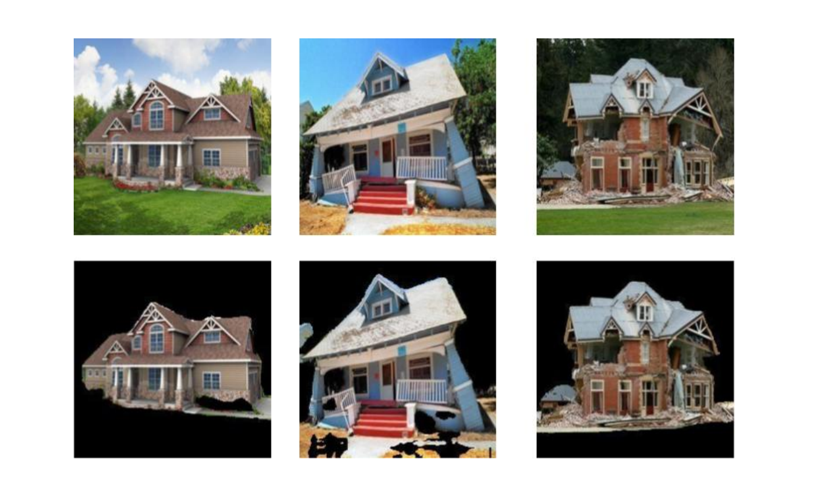

Slide 30
Future Directions
Collecting a better dataset in terms of image count and quality
Using multi-task learning instead of single-task learning
Using more class categories

Slide 31
References
Turker, M. and San, B. T.Detection of collapsed buildings caused by the 1999 Izmit, Turkey earthquake through digital analysis of post-event aerial photographs, 2004. URL https://doi.org/10.1080/01431160410001709976.
Nia, K. R. and Mori, G. Building damage assessment using deep learning and ground-level image data, May 2017.
Cooner, A., Shao, Y., and Campbell, J. Detection of urban damage using remote sensing and machine learning algorithms: Revisiting the 2010 Haiti earthquake, Oct 2016.ISSN 2072-4292. URL http://dx.doi.org/10.3390/rs8100868.

